Slide 1
How to Teach Computers to Recognize Things S2: Dataset Preparation: Building our Perfect “Textbooks”
Dr. Du Pengfei
CPPS/DMD
4th July 2024

Slide 2
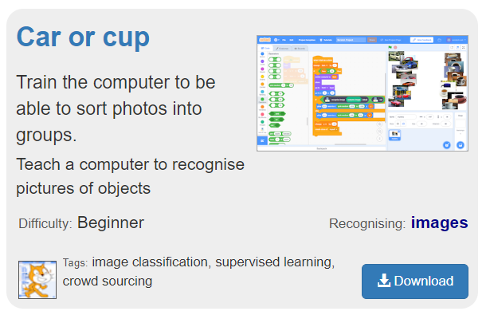
Recap: Car OR Cup
Bear in Mind while conducting your AI Project:
Is Data sufficient for training?
Is Data of high quality including all scenarios without bias?
Aim: to Building our Perfect “Textbooks” for AI !

Slide 3

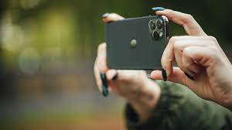
Agenda
Briefing: Image Filtering and preparation towards Perfect Textbook
Second half: Two Hands-On Project
Car Or Cup | Fruit Fooled | Rock Paper Scissors
2 labels Image Classification Online images ONLY Easy Task | > 2 labels Image Classification [Fruit Classification] Online images ONLY Intermediate Task | > 2 labels Image Classification of Hand-gesture Local representation + Online images Advanced Task

Slide 4
Rules of Thumb: Pictures Filtering
Assure one single object per image [Try image crop tool]
No blurry images
Complete Object (No occlusion or obstruction or partial body)
Relatively clear background (Sufficient Contrast)
Balanced Label

Slide 5


Examples: Cars
Notes:
https://www.youtube.com/watch?v=2hXG8v8p0KM

Slide 6
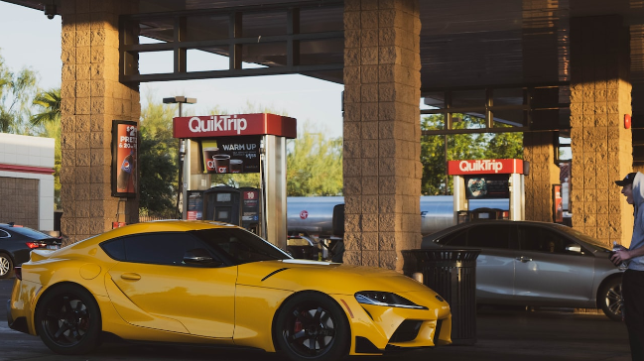

Examples: Cars
Notes:
https://www.youtube.com/watch?v=2hXG8v8p0KM

Slide 7
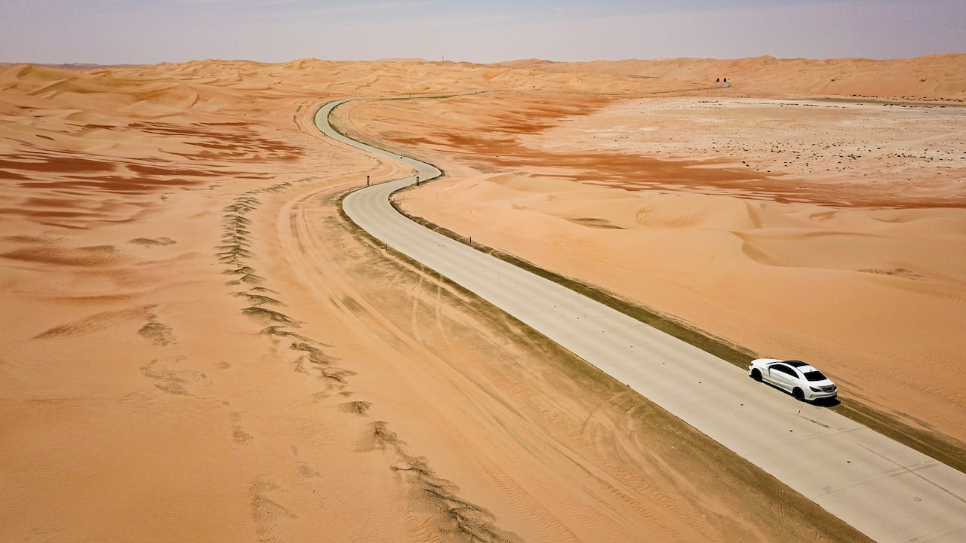
Examples: Cars
Notes:
https://www.youtube.com/watch?v=2hXG8v8p0KM

Slide 8

Examples: Cars
Notes:
https://www.youtube.com/watch?v=2hXG8v8p0KM

Slide 9
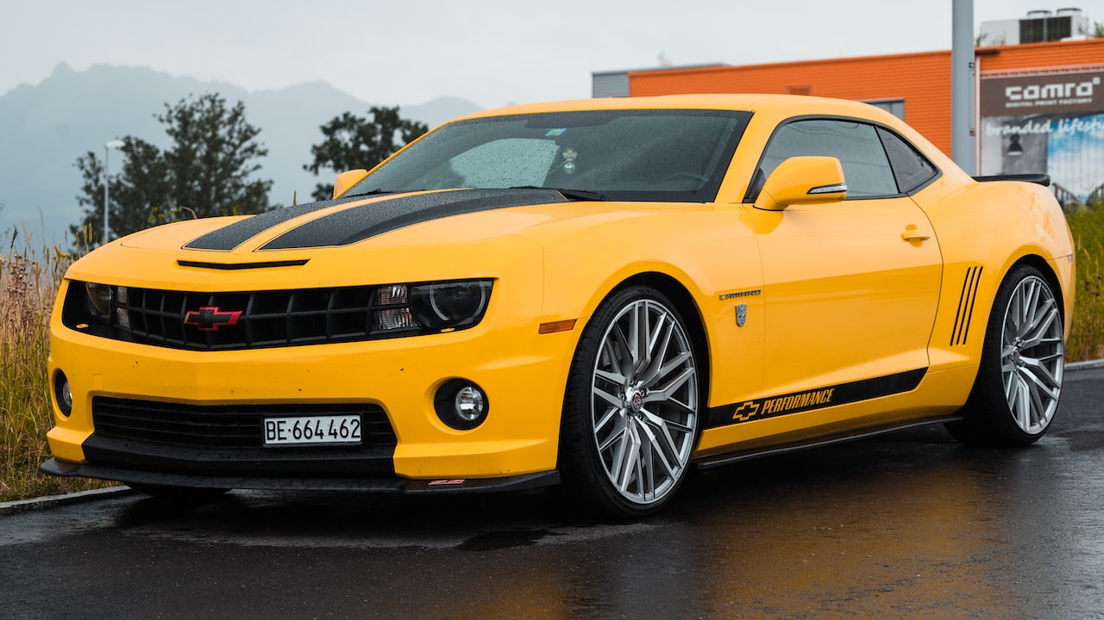
Examples: Cars
Notes:
https://www.youtube.com/watch?v=2hXG8v8p0KM

Slide 10

Examples: Cars and People
Notes:
https://www.youtube.com/watch?v=2hXG8v8p0KM

Slide 11
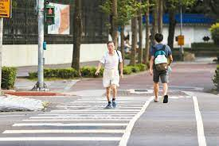
Examples: Cars and People
Notes:
https://www.youtube.com/watch?v=2hXG8v8p0KM

Slide 12
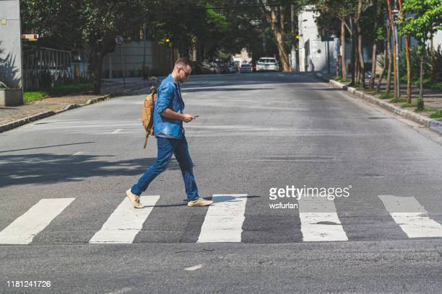
Examples: Cars and People
Notes:
https://www.youtube.com/watch?v=2hXG8v8p0KM

Slide 13
Examples: Cars and People
Notes:
https://www.youtube.com/watch?v=2hXG8v8p0KM

Slide 14
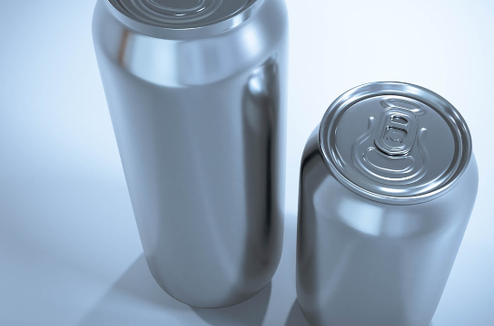
Examples: Recyclables
Notes:
https://www.youtube.com/watch?v=2hXG8v8p0KM

Slide 15

Examples: Recyclables
Notes:
https://www.youtube.com/watch?v=2hXG8v8p0KM

Slide 16
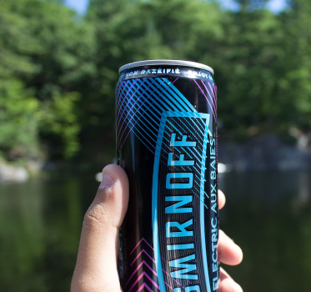
Examples: Recyclables
Notes:
https://www.youtube.com/watch?v=2hXG8v8p0KM

Slide 17
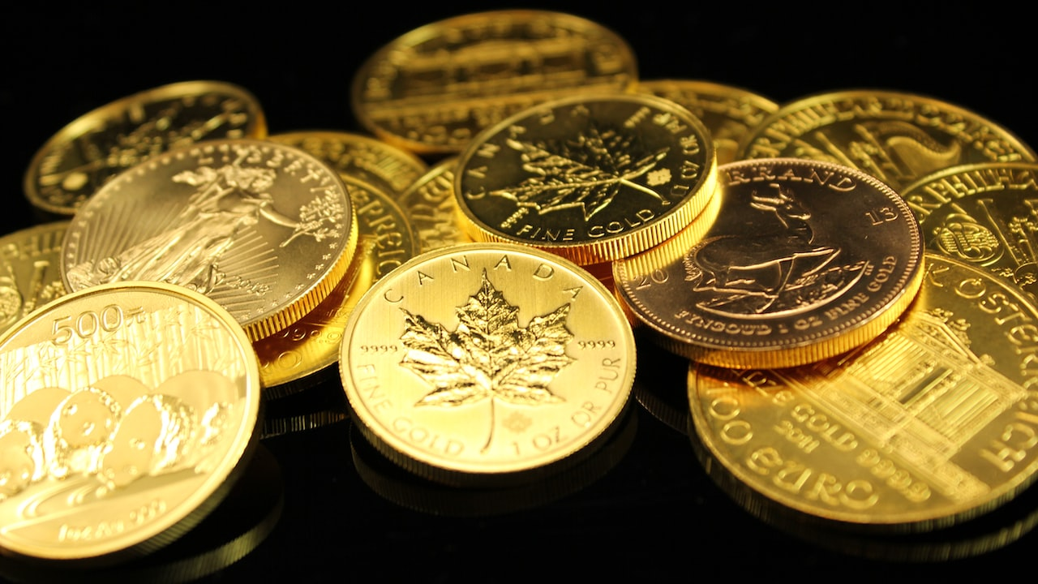
Examples: Coins
Notes:
https://www.youtube.com/watch?v=2hXG8v8p0KM

Slide 18

Examples: Coins
Notes:
https://www.youtube.com/watch?v=2hXG8v8p0KM

Slide 19
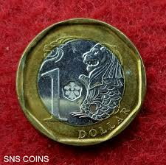
Examples: Coins
Notes:
https://www.youtube.com/watch?v=2hXG8v8p0KM

Slide 20
Let’s Start Project: Fruit Fooled
General steps of building A.I. in our real-world:
Image Capture → Annotation → Training → Testing
Teacher preparing textbooks
attending class
Examination
Bear in Mind while conducting your AI Project:
Is Data sufficient for training?
Is Data of high quality including all scenarios without bias?
Notes:
https://www.youtube.com/watch?v=2hXG8v8p0KM

Slide 21
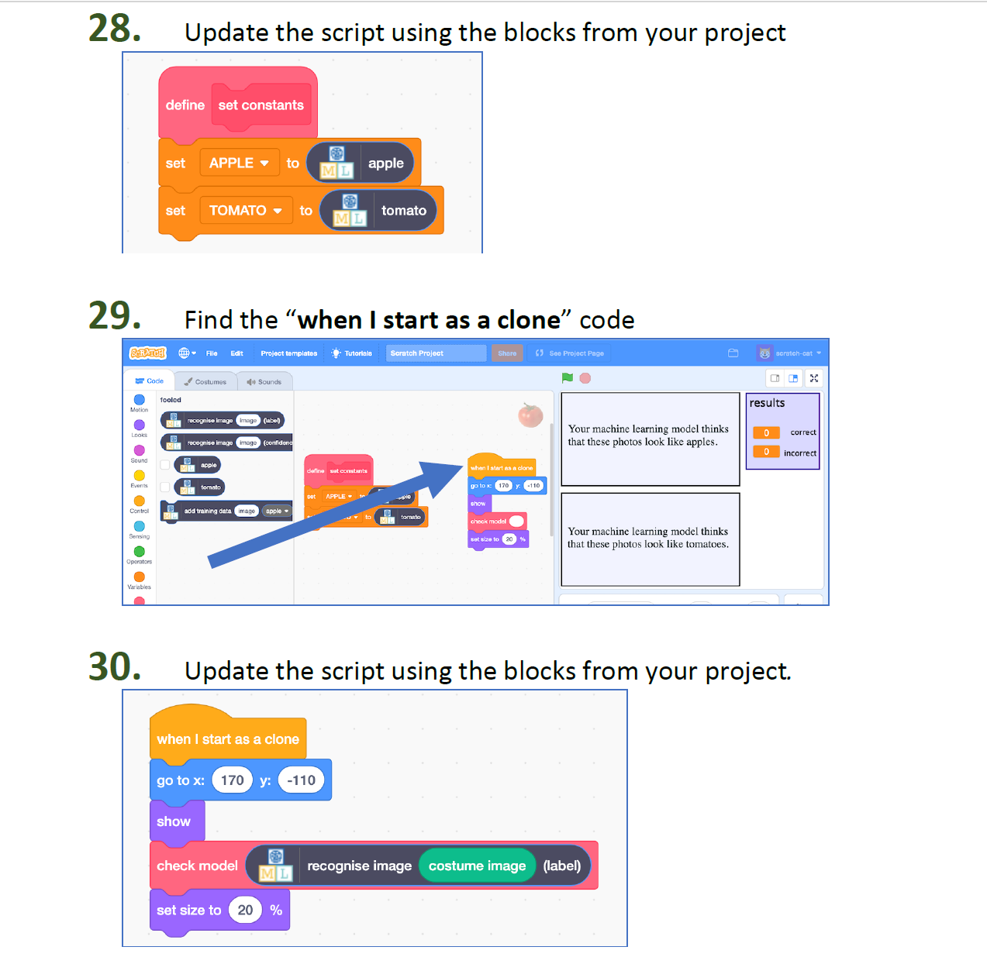
Codes of Fruit Fooled
Notes:
https://www.youtube.com/watch?v=2hXG8v8p0KM

Slide 22
Let’s Start Project: Fruit Fooled
Notes:
https://www.youtube.com/watch?v=2hXG8v8p0KM

Slide 23
Rules of Thumb: Pictures Filtering
Adding Local Representation to your textbook
Bear in Mind while conducting your AI Project:
Is Data sufficient for training?
Is Data of high quality including all scenarios without bias?
Can, Can
Chat GPT
??
Kopi O Gosong
No lah, can meh?

Slide 24
Rules of Thumb: Pictures Filtering
Adding Local Representation to your textbook
Bear in Mind while conducting your AI Project:
Is Data sufficient for training?
Is Data of high quality including all scenarios without bias?

Slide 25
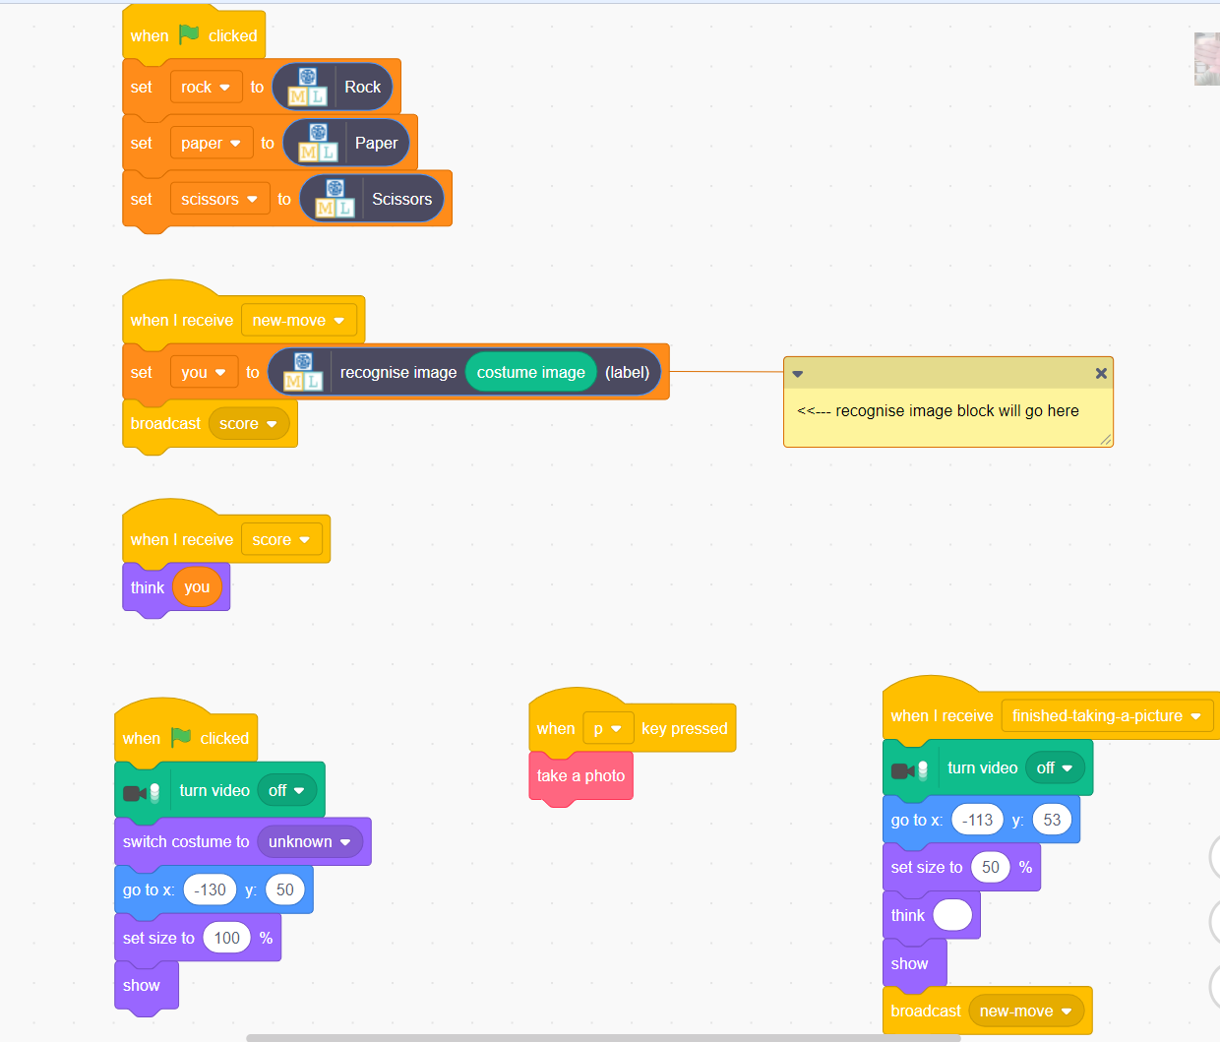
Rock Paper Scissors with Computer
Notes:
https://www.youtube.com/watch?v=2hXG8v8p0KM

Slide 26
Rock Paper Scissors with Computer
Things To Note:
Ensure Majority part of image is RPS
Bear in Mind while conducting your AI Project:
Is Data sufficient for training?
Is Data of high quality including all scenarios without bias?
Notes:
https://www.youtube.com/watch?v=2hXG8v8p0KM

Slide 27
Rock Paper Scissors with Computer
Things To Note:
2. Ensure images are different diverse!
Bear in Mind while conducting your AI Project:
Is Data sufficient for training?
Is Data of high quality including all scenarios without bias?
Notes:
https://www.youtube.com/watch?v=2hXG8v8p0KM

Slide 28
Rock Paper Scissors with Computer
Let’s Start!! Collecting Online First, Then Taking Pictures using Webcam, Then Filtering!!
Notes:
https://www.youtube.com/watch?v=2hXG8v8p0KM

Slide 29
Contact: Du Pengfei
du_pengfei@SIMTech.a-star.edu.sg

Slide 30
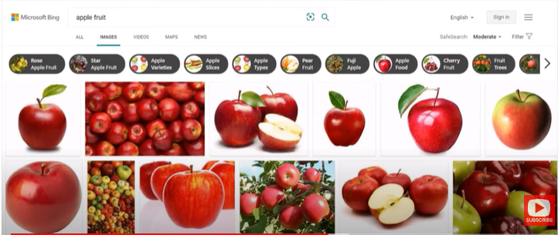
Extension: Bing Image Downloader
https://youtu.be/solASfMs89Q
Notes:
https://www.youtube.com/watch?v=2hXG8v8p0KM

